Slide 1
Power BI Pivot Table
Session- 7 Practical-4
Farha Imthiyaz,
BSc (Hons) in Software Engineering
(Solent University, UK),
MS in Data Science (Reading)
(NED University of Engineering & Technology, Karachi)

Slide 2

Road Map
Follow the steps and Practice them.
Use Power BI Pivot Table Excel file for this practical which I shared with you in the session.
Mainly Two parts
How to Create a Pivot Table in Power BI?
Pivot and Un-Pivot Columns in Power BI Table

Slide 3
How to Create a Pivot Table in Power BI?

Slide 4
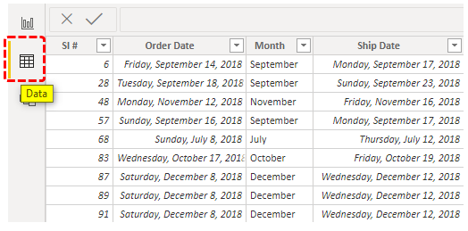
1. Upload the data to the Power BI file.

Slide 5
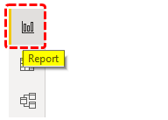
2. Come back to the “Report” tab to create a summary table.

Slide 6
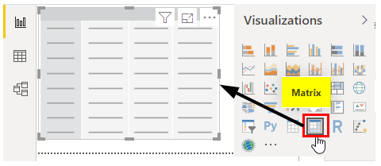
3. From the visualization, the list inserts “Matrix” visual

Slide 7
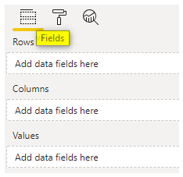
4. This matrix visual has the below fields.
Rows are nothing but on “Row-wise” what we want to see.
Columns are nothing on “Colum-wise” what we want to see.
Values, i.e., which column values we need to see as a summary table.

Slide 8
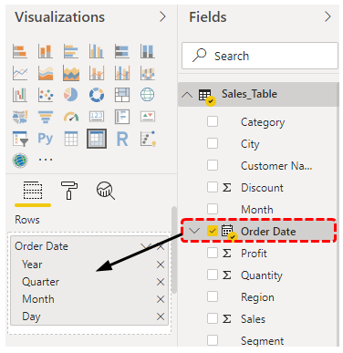
5. we want to see “Monthly” “Category-wise” sales value. Fist drag and drop the “Date” column to the “Rows” field

Slide 9
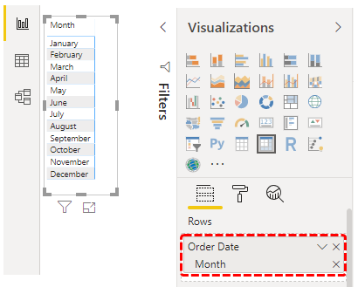
6. we can see “Year, Quarter, Month, and Day” since we need to see monthly summary cancel all except “Month.”

Slide 10
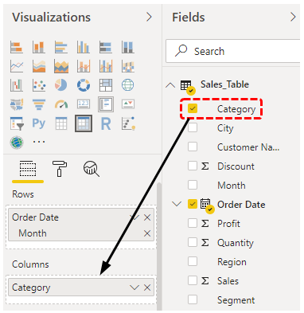
7. Now drag and drop the “Category” column to “Columns.”

Slide 11
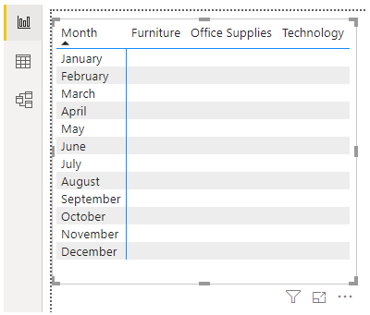
8. Now we could see a table like this

Slide 12
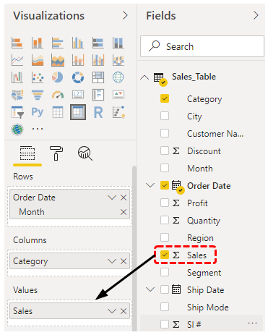
9. we need to see a “Sales” column summary, drag and drop the “Sales” column to the “Values” field of the “Matrix” visual.

Slide 13
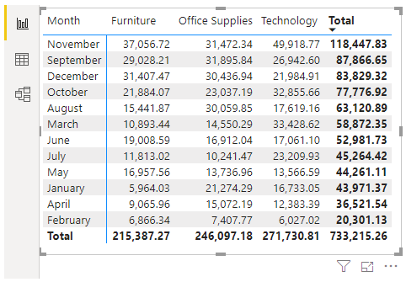
10. This will bring us the summary table, which looks like the “Pivot Table” in excel.

Slide 14
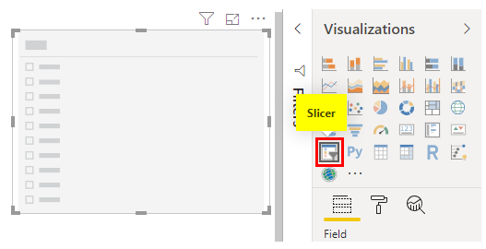
12. Insert a slicer visual from the visualization list.

Slide 15
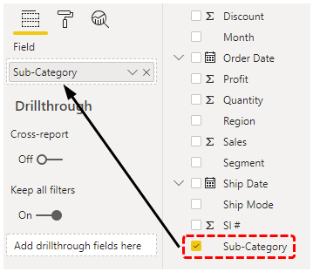
13. For this slicer field, drag and drop “Sub Category” column from the table.

Slide 16
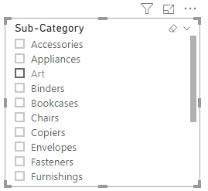
14. Now we could see “Sub Category” names in the slicer.

Slide 17
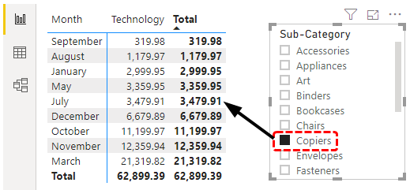
15. Now, if we want to see only the “Copiers” subcategory summary table, then choose only “Copiers” from the slicer, and it will filter the data in the “Matrix” table as well.

Slide 18
Pivot and Un-Pivot Columns in Power BI Table

Slide 19
A. Pivot Columns in Power BI Table

Slide 20
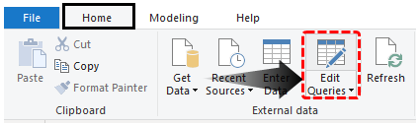
Step 1: Upload the file to Power BI, under the home tab, click on “Edit Queries.

Slide 21
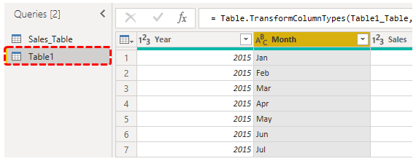
Step 2: Choose the table and choose the “Month” column

Slide 22
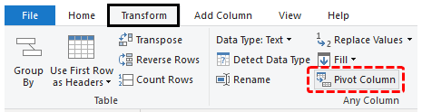
Step 3: Under the “Transform” tab, click on “Pivot Column.”

Slide 23
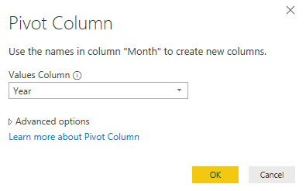
This will open the “Pivot Column” window.

Slide 24
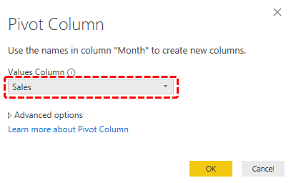
Step 4: we need to choose “Values Column” as “Sales” because this is the column we are grouping together.

Slide 25
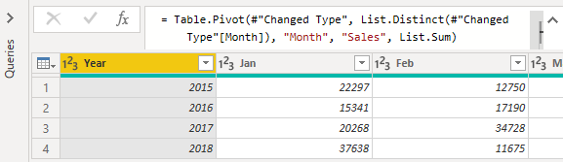
Step 5: Now click on, Ok, and it will pivot the columns.

Slide 26
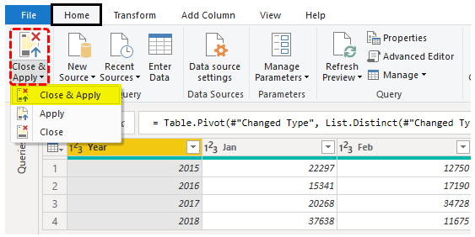
Step 6: Click on “Close and Apply” to see the real result.

Slide 27
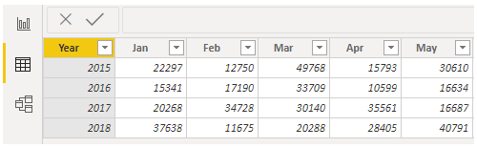
The real result is shown below.

Slide 28
B. UnPivot Columns in Power BI Table

Slide 29
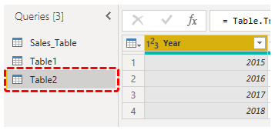
Step 1: From Power, Query window, choose the table, and choose the “Year” column.

Slide 30
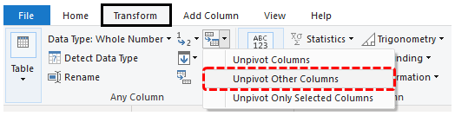
Step 2: Under the “Transform” tab, click on “Un-Pivot >>> Un-Pivot Other Columns.”

Slide 31
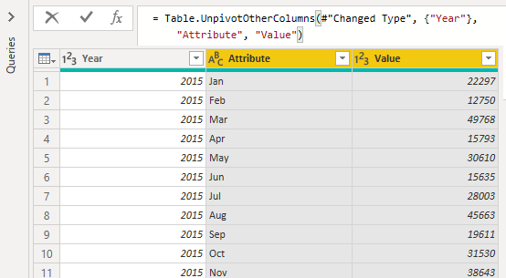
This will un-pivot columns.

Slide 32


